Slide 1

Topic of Project
Mental Health Prediction of people by using their Facebook user account data
Team-ethi-mental-state-42
Members :- Gowtham, Vansh, Nandita, J Shelly

Slide 2
Vision of our Project
Make your personal data your closest mentor
Predict, monitor and highlight key traits of your personality from social media activity
Use your personal data first for your personal growth, then sell to others for marketing
Transfer autonomy of your personal data to you

Slide 3
How will we accomplish that ?
With your permission, access your Facebook account data
Analyze it using intelligent machine learning algorithm
Extract meaningful insights and show in easy-to-understand interactive dashboard
Highlight key points to guide you to achieve your self-improvement goals

Slide 4
Overview of our Model
Input from your Facebook Account
Whatever you post with your account
Messages you send to individual person or groups
Anything you comment about
Output on your Dashboard
Categorize your posts, messages and comments into : Positive, Negative and Neutral
Show relative trend of your mental state with respect to time to clearly show how your mood (positive, neutral and negative) was varying as your grew
Show top 5 people you were in close touch with respect to time
Show top 5 groups your were most active with respect to time

Slide 5
Let’s understand more about code
Feature 1 - Predicting the mood of the user by analysing the posts done by the user:
Used TextBlob library on the posts made by the user to perform sentiment analysis.
Preprocessed the data using regex for more accurate results
Visualized the posts made by the user for three different categories – Positive, Negative and Neutral posts
Feature 2 - Top people on Messenger:
Extracted all the messages sent by the user. Mainly the user will be a part of a group or might text someone individually.
A person was considered as a close friend if the user texts a person (because there might be someone spamming, so considered if only the user texts the person).
Used dictionary instead of list because there were cases with more than one json file for a person. This happened because someone might have texted too often and the data was store in more than one file.
Top friends from the findings were displayed as a bar chart.

Slide 6
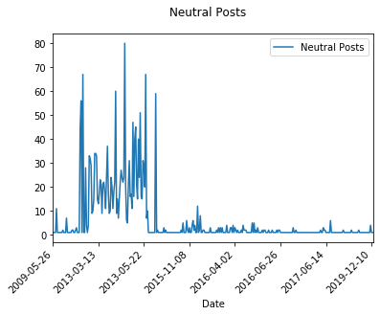
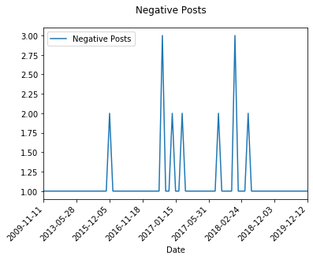
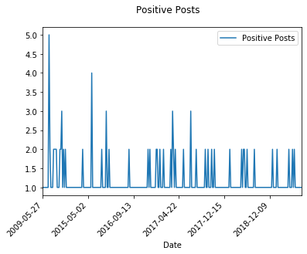
Feature 1 - Insights

Slide 7
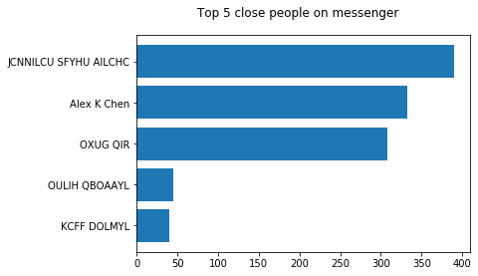
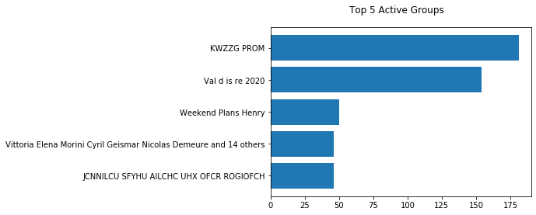
Feature 2 - Insights

Slide 8
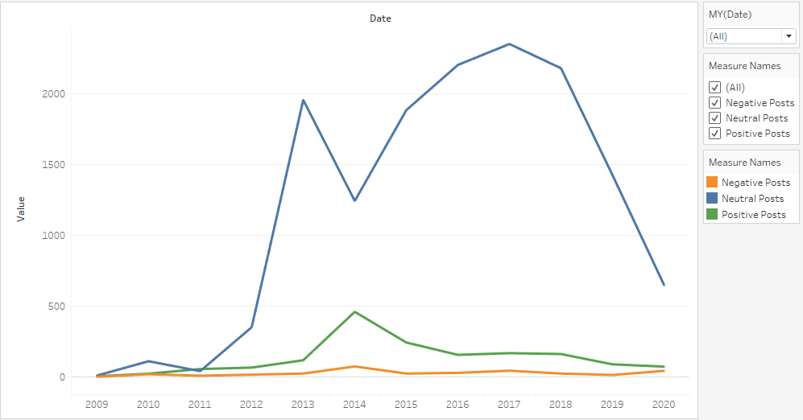
Dashboard
It shows relative trend of your mental mood
Filters used : Date, Mood type

